Slide 1
Final project
Rico Timotius Gotama
Web Design dengan HTML5, CSS3 beginner 2.0

Slide 2
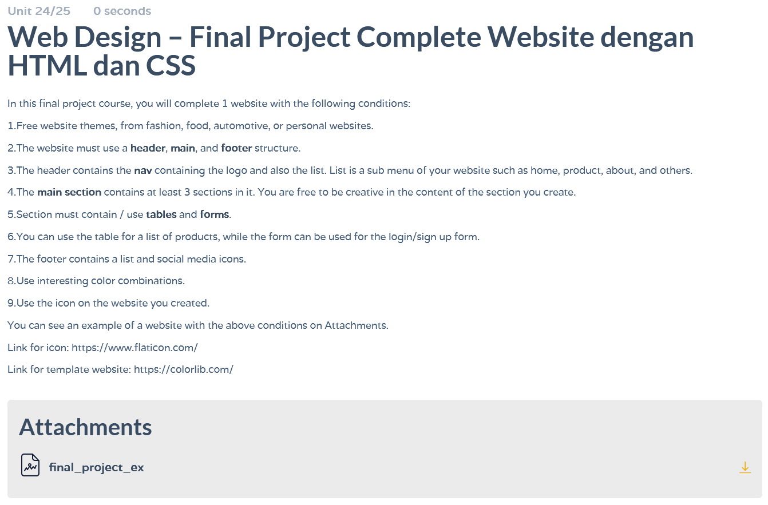

Slide 3
Source code web

Slide 4
<hr style="width: 100%;">
<div>
<img class="FE4" src="FE Images/Analytics.jpg" alt="Analytics">
<div class="FE5">
<div class="F1">A Complete Business Solution</div>
<p class="F2">Analyse Your Data In Real Time</p>
<p class="F3">Together With ORACLE, Create Business Opportunities</p>
<input class="F4"
type="text";
placeholder="Enter your email";>
<button>Subscribe</button>
</div>
</div>

Slide 5
<div class="FE27">
<img class="FE28" src="FE Images/Oracle Logo.jpg" alt="Oracle">
<div class="FE29">
<p style="font-size: 18pt;">Quick Links</p>
<div class="FE31">
<p style="font-size: 18pt;">Newsletter</p>
<p>Subscribe newsletter to get updates...</p>
<input class="FE32"
type="text";
placeholder="Enter your email";>
<button class="fa fa-home"></button>
</div>
</div>

Slide 6
.FE1{
width: 90px;
float: left;
}
.FE2{
text-align: center;
float: left;
padding-left: 150px;
padding-top: 20px;
}
.FE3{
text-align: center;
float: left;
padding-left: 150px;
padding-top: 20px;
}
.F1{
background-color: darkgray;
border-radius: 5px;
margin-right: 83%;
font-size: 14pt;
color: whitesmoke;
}

Slide 7
Terima KASIH

